Slide 1
SECURE DATA HIDING IN IMAGES USING STEGANOGRAPHY
CAPSTONE PROJECT
Presented By: GOPINATH S
Student Name : GOPINATH S
College Name & Department : Adhiyamaan College of Engineering(Autonomous), Department of Information Technology

Slide 2
OUTLINE
Problem Statement
Technology used
Wow factor
End users
Result
Conclusion
Git-hub Link
Future scope

Slide 3
Problem Statement
Certainly! Here’s your revised content with clearer point separation:
Growing Security Needs: As the need for secure data transfer increases, traditional encryption techniques are often vulnerable to interception and decryption by unauthorized parties.
Limitations of Traditional Methods: Conventional data protection methods can raise suspicion, making them susceptible to attacks.
The Need for a New Approach: To securely integrate sensitive information into digital media without compromising perceptual quality, a discreet, reliable, and effective method is essential.
Focus of the Solution: The solution will concentrate on:
Improving embedding efficiency
Enhancing resilience to attacks
Preserving the visual integrity of the carrier image
Project Objective: The goal of this project is to create a Steganography-based Secure Data Hiding in Images system that ensures:
Private information is securely hidden within images
The hidden data remains imperceptible to the naked eye
The system is highly resistant to steganalysis techniques

Slide 4
Technology used
Libraries Used in the Program:
OpenCV (cv2) – Used for reading, modifying, and saving images.
OS (Used to execute system commands (e.g., opening the encrypted image).
String (Provides character manipulation utilities (though not used explicitly).
Platform Compatibility:
The program is designed for Windows (due to os.system("start encryptedImage.jpg") for opening the image).
It can run on Linux/macOS with minor
Requires Python 3.x with OpenCV (cv2) installed (pip install opencv-python).

Slide 5
Wow factors
UNIQUE FACTORS:
Custom Encryption and Secure Data Hiding in Images
Passkey-Enabled Real-Time Image Steganography
Innovative Steganography: Custom Encryption with Passkey Decryption

Slide 6
End users
End Users of the Project :
Cybersecurity Professionals
Corporate & Business Organizations
Privacy-Conscious Individuals

Slide 7

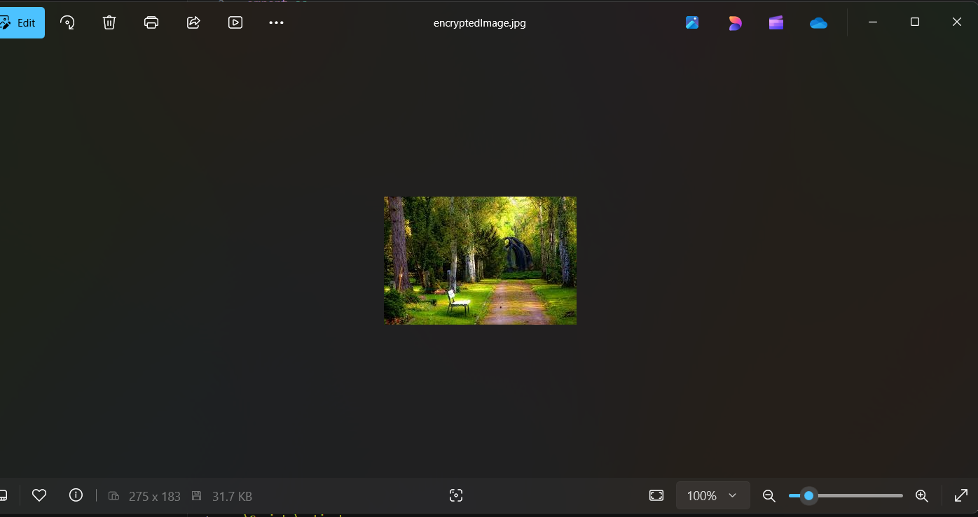
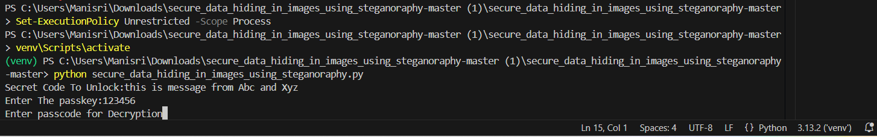
Results

Slide 8
Conclusion
Here’s the revised version with some changes for clarity and flow:
Safeguarding Information Concealed in Images
The challenge of securely transferring secret data is effectively addressed by the Steganography project, which embeds confidential information within digital images while maintaining their visual integrity. Unlike traditional encryption methods, which can attract attention and be vulnerable to interception, this technology ensures that sensitive communications remain imperceptible to unauthorized individuals.
The solution enhances security by incorporating passkey-protected decryption and direct pixel manipulation techniques. By utilizing a lightweight yet robust steganographic approach, the system guarantees minimal distortion to the image, making it a perfect solution for secure communication across various sectors, including cybersecurity, law enforcement, and corporate data protection.

Slide 9
GitHub Link
The GitHub link : https://github.com/GopinathS1611/secure_data_hiding_in_images_using_steganoraphy.git

Slide 10
Future scope(optional)
My Future Scope in Cyber Security is to learn about to protect myself from cyber threats and protect my identity

Slide 11
THANK YOU

